Slide 1

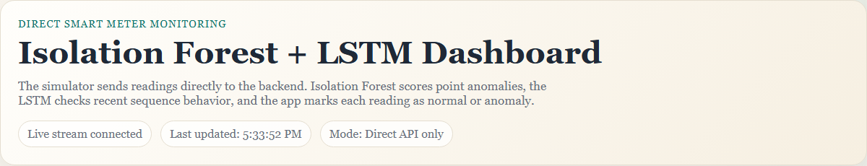
Smart Meter Anomaly Detection Dashboard
MCA Project
Submitted by: Devendra Singh Shakya
Enrollment No: CUOL909961
Guide: Vasanthi Chandran

Slide 2
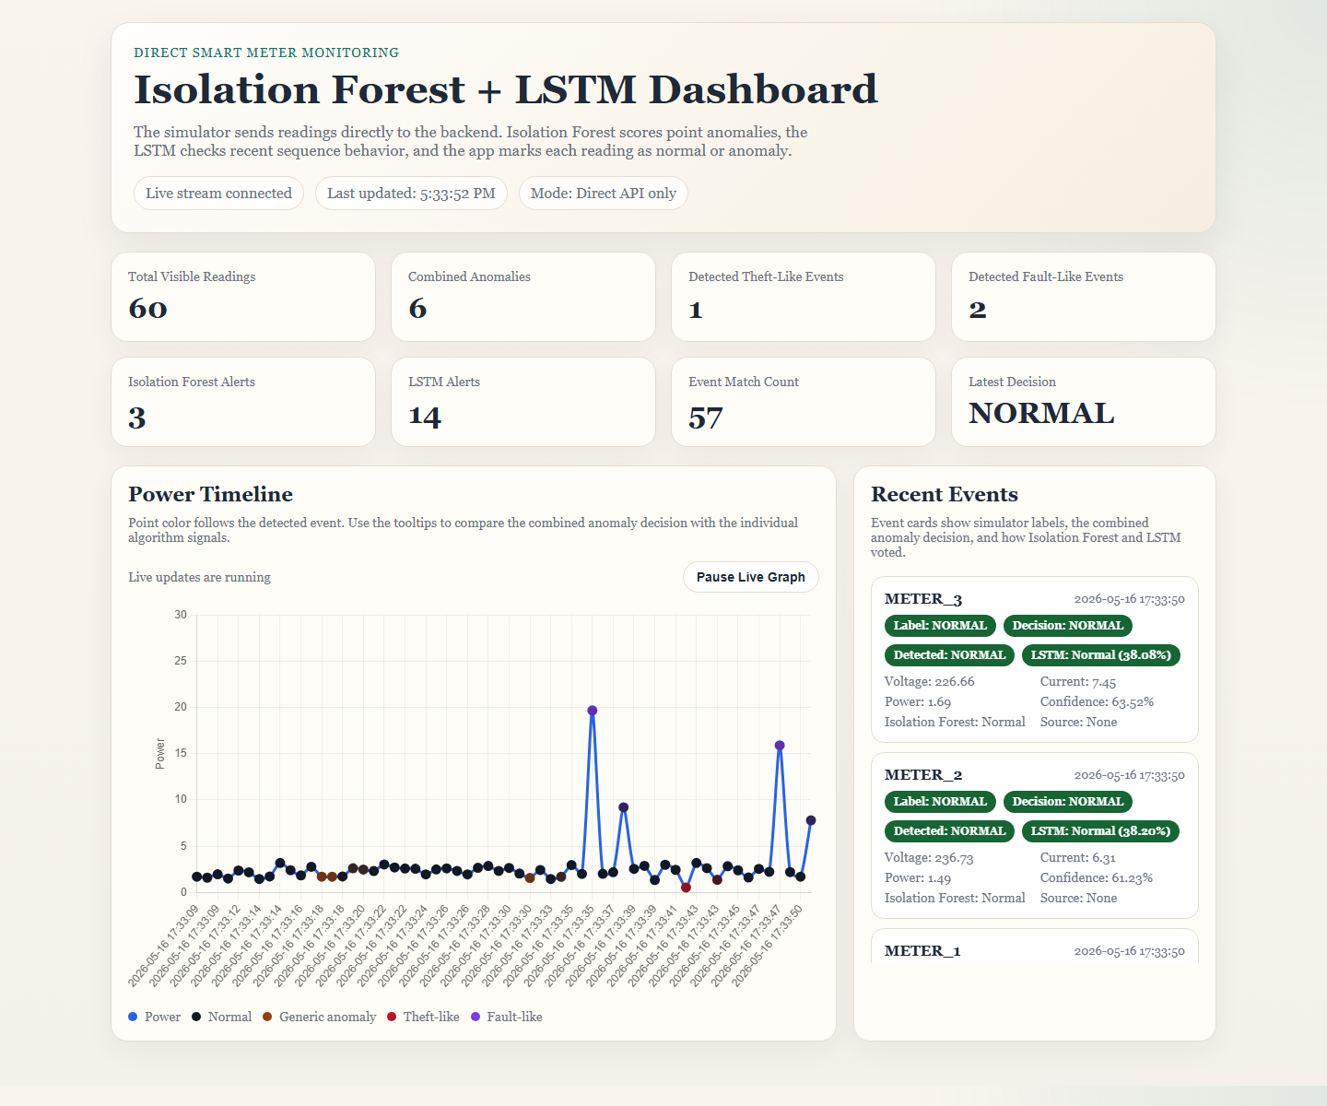
Introduction
Smart meters produce continuous readings.
Manual monitoring is difficult for large data.
Abnormal readings may indicate theft-like or fault-like behavior.
This project detects anomalies and visualizes them in real time.
Live dashboard shows readings, events and confidence.

Slide 3
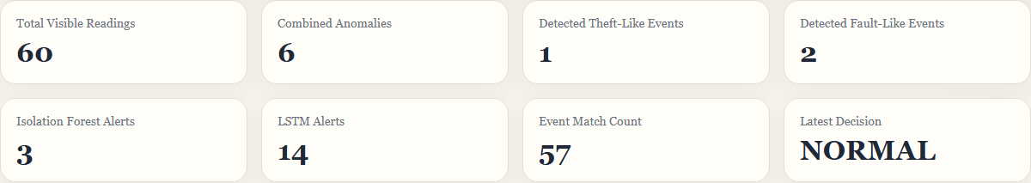
Problem Statement & Objectives
Traditional systems depend on manual checks or fixed thresholds.
Real-time abnormal behavior may be missed.
Collect and preprocess voltage, current and power readings.
Detect anomalies using Isolation Forest and LSTM.
Evaluate detection using simulated spikes.

Slide 4
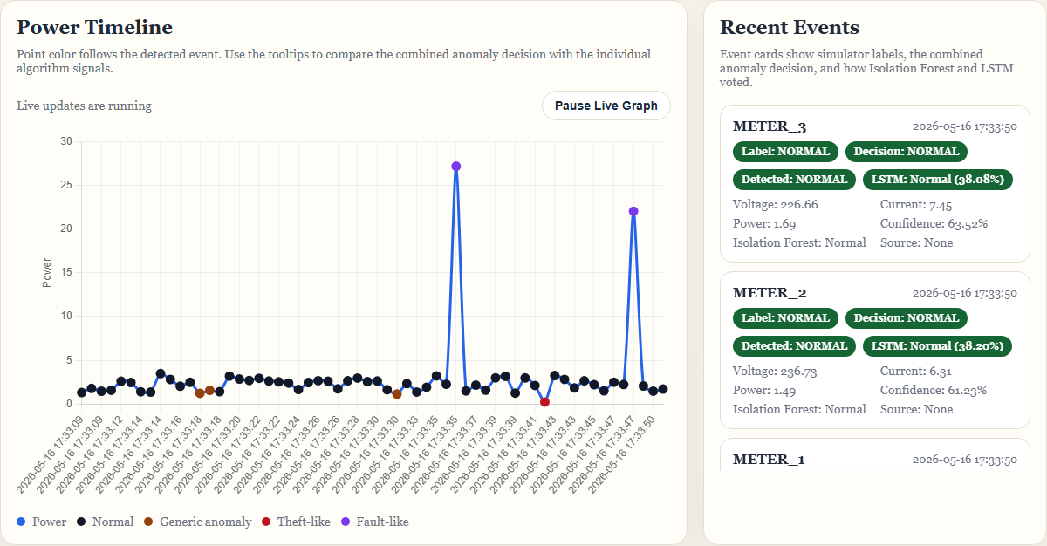
Proposed System
Historical data is used for model training.
Live readings are generated by a simulator.
FastAPI backend performs anomaly detection.
Flask and Chart.js dashboard shows live results.
System classifies NORMAL, THEFT, FAULT or ANOMALY.

Slide 5
System Architecture
sample_data.csv -> train_model.py
train_model.py -> artifacts/
meter_simulator.py -> backend.py
backend.py -> flask_app.py -> dashboard
Dashboard displays live decisions and event status.

Slide 6
Dataset & Preprocessing
Dataset file: sample_data.csv
Features used: voltage, current and power.
Feature selection and normal baseline preparation.
Standard scaling for Isolation Forest.
Sequence window creation and threshold learning for LSTM.

Slide 7
Algorithms Used
Isolation Forest detects point anomalies.
It is useful for sudden abnormal readings.
LSTM detects sequence anomalies.
It uses recent power history per meter.
Combined output improves event detection.

Slide 8
Backend & Simulator
FastAPI implements POST /data and GET /data.
Backend outputs prediction, event, confidence, match and source.
meter_simulator.py generates readings for multiple meters.
Simulator injects low-power theft-like spikes.
Simulator injects high-power fault-like spikes.

Slide 9
Dashboard
Implemented using Flask, HTML, CSS, JavaScript and Chart.js.
Shows live power timeline.
Displays recent event cards.
Shows anomaly counts, model outputs and confidence.
Uses real-time data from backend API.

Slide 10
Testing & Results
Tests are written using pytest.
Backend helper logic and event classification are tested.
LSTM warmup and combined model decisions are tested.
Theft-like and fault-like events are detected from spikes.
Dashboard updates live with model decisions.

Slide 11
Conclusion & Future Scope
Project demonstrates an AI-based smart meter monitoring workflow.
Combines preprocessing, anomaly detection and live visualization.
Advantages: real-time monitoring, ML models and multi-meter support.
Limitations: simulated readings, no database and no SMS/email alerts.
Future: real meter integration, cloud deployment and retraining.

Slide 12
Thank You

